Slide 1
Pokemon Infinite FuseGan
Danvi, Michael, Moeed

Slide 2









Pokemon
Notes:
Mike
Talk about pokemon in general
Highest earning franchise in history
Over 1000 pokemon from 16 mainline games over the last 26 years

Slide 3
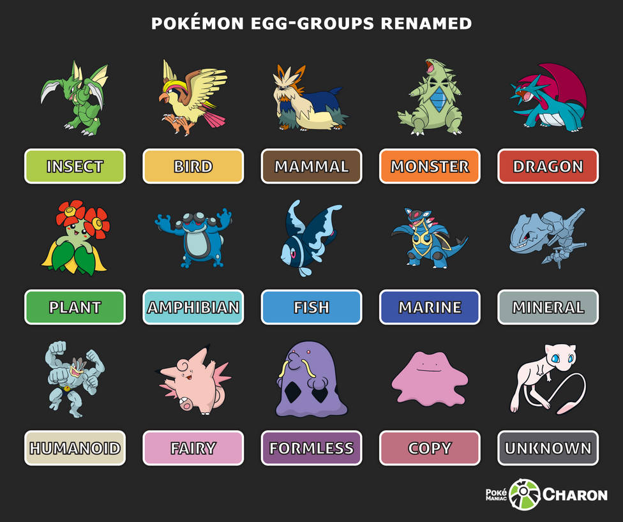
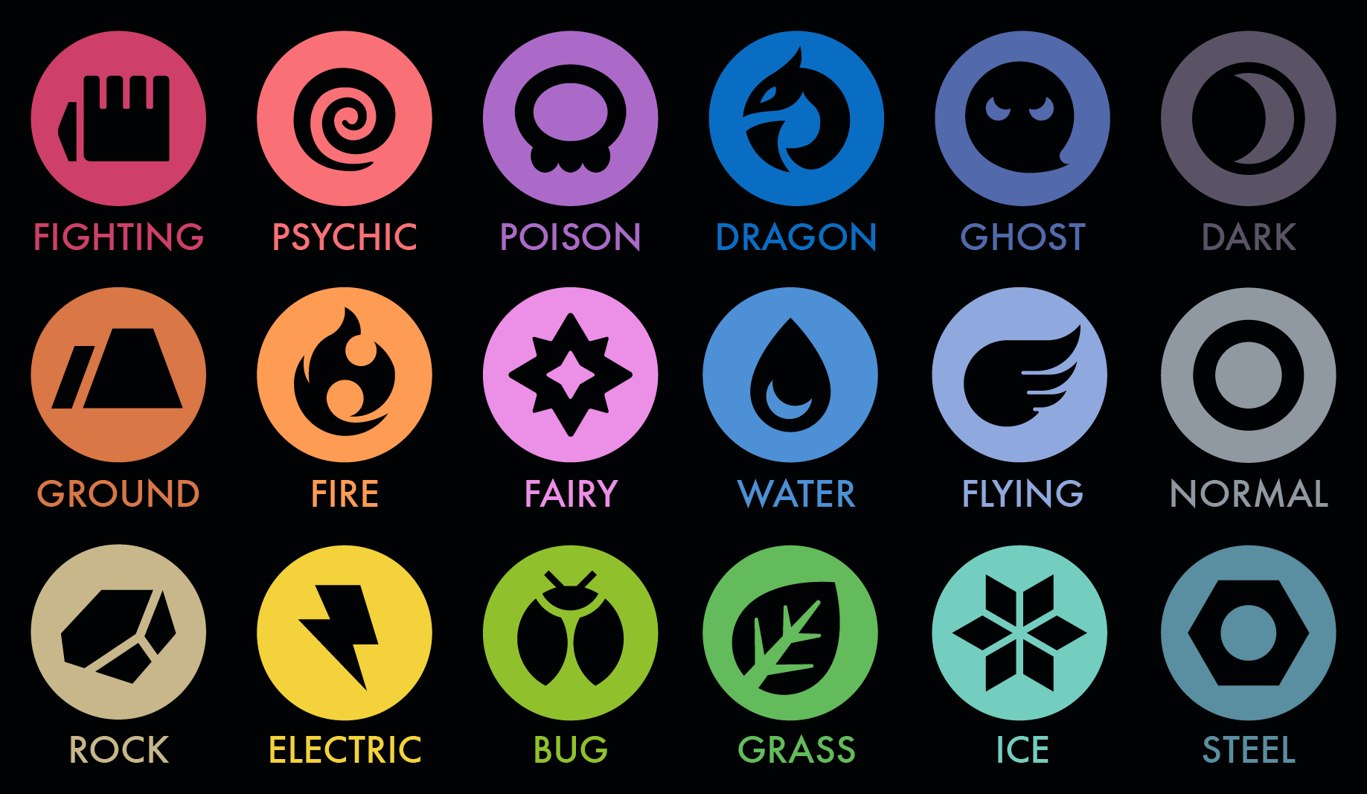
Pokemon Categories
Notes:
Mike
Pokemon can be categroized as such

Slide 4












Infinite Fusion
Notes:
Mike
Overview of infinite fusion
Show examples of 2 and 3 fused pokemon

Slide 5
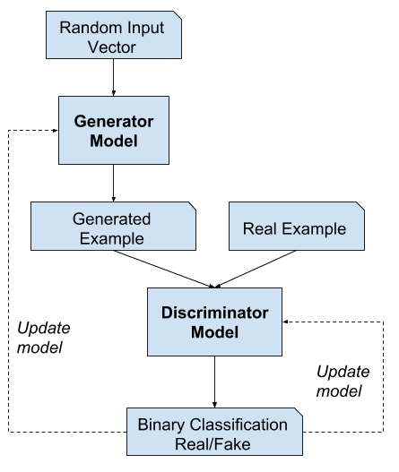
Generative Adversarial Networks

Slide 6
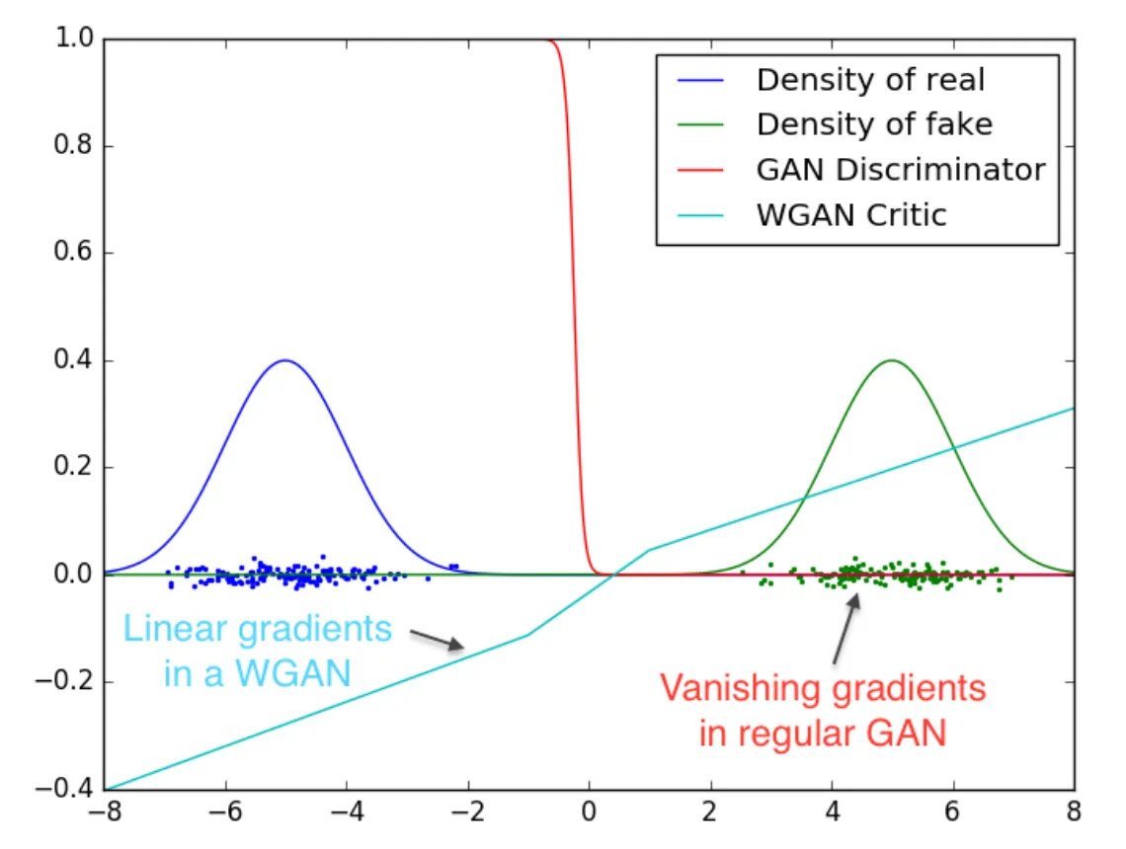
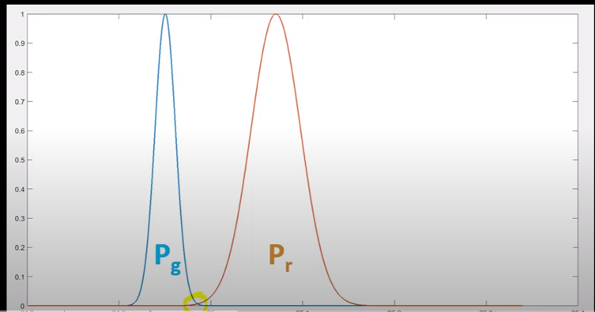
Wasserstein Gan
Notes:
Go over how WSGan works
We ran wgan for better stability. in wgan we get some feedback from the loss.
our goal is to get pg and pr similar to generate realistic looking images.
Pg : distribution that come out from the generator
Pr: distribution that comes from real images.
Talk about how the cost function is different with wasserstein distance
The cost function associated with the Wasserstein distance essentially evaluates the minimum cost of transforming the mass from one distribution into the other, considering the distance and the amount of mass being transported. This makes it an effective metric for analyzing and comparing probability distributions with varying shapes and sizes.

Slide 7
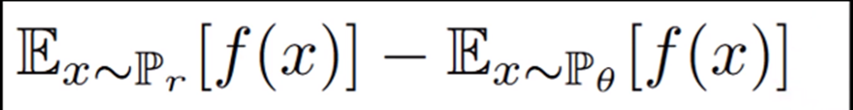
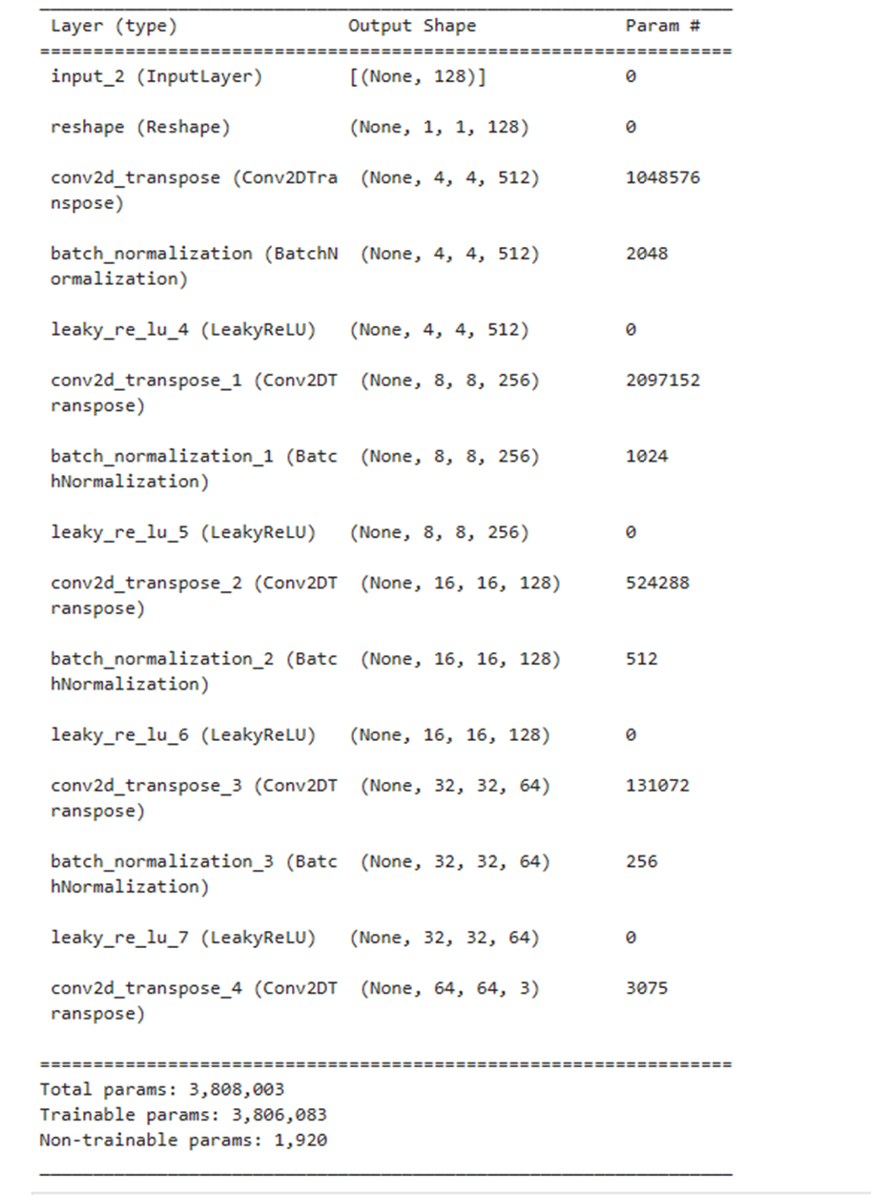
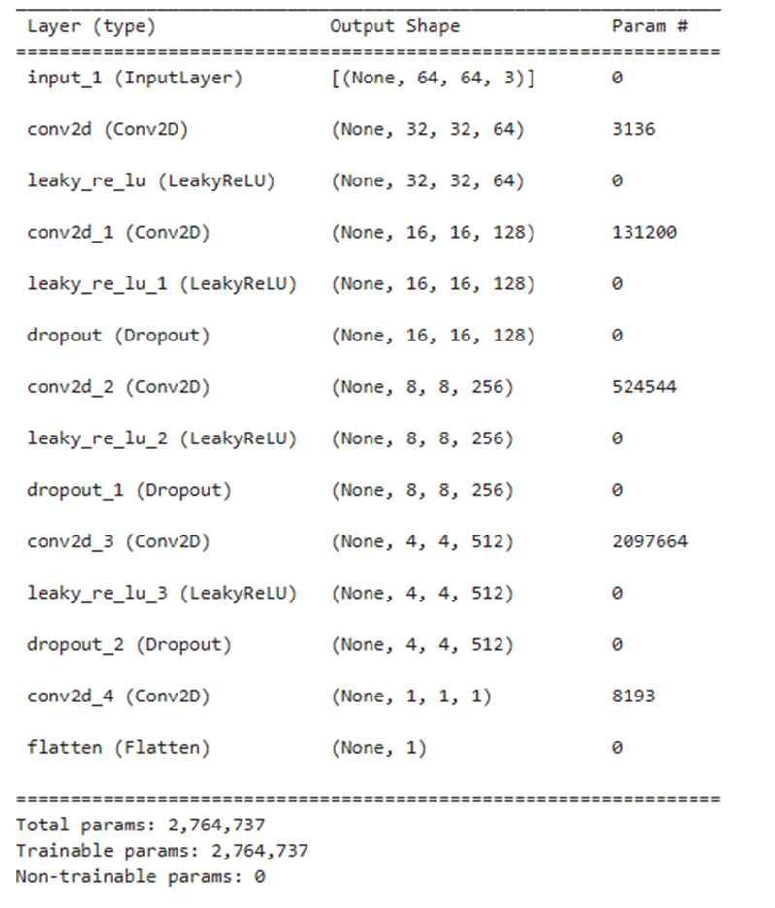
WGAN
generator
critic
Notes:
Discriminator wants to separate these as much as possible. (maximize)
Generator wants to put these to closer to each other (minimize) .So, when the generator is very close to 0 the discriminator cannot distinguish the images from the real ones.

Slide 8
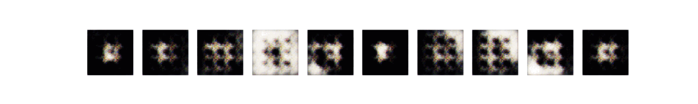
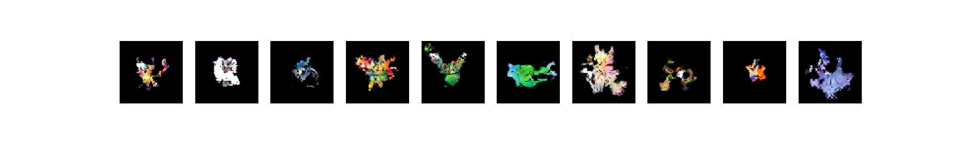
WSGAN - Output
Notes:
Go Over our output
Approximate shape compared to cgan. Needs more training
Not using labeling

Slide 9
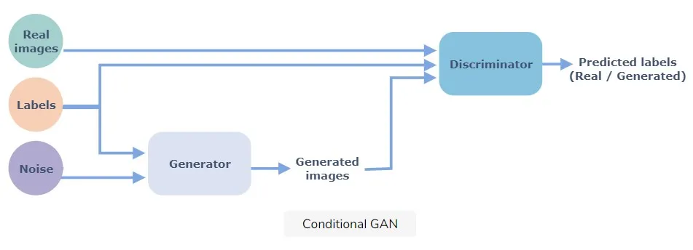
Conditional GAN
Notes:
Mike

Slide 10
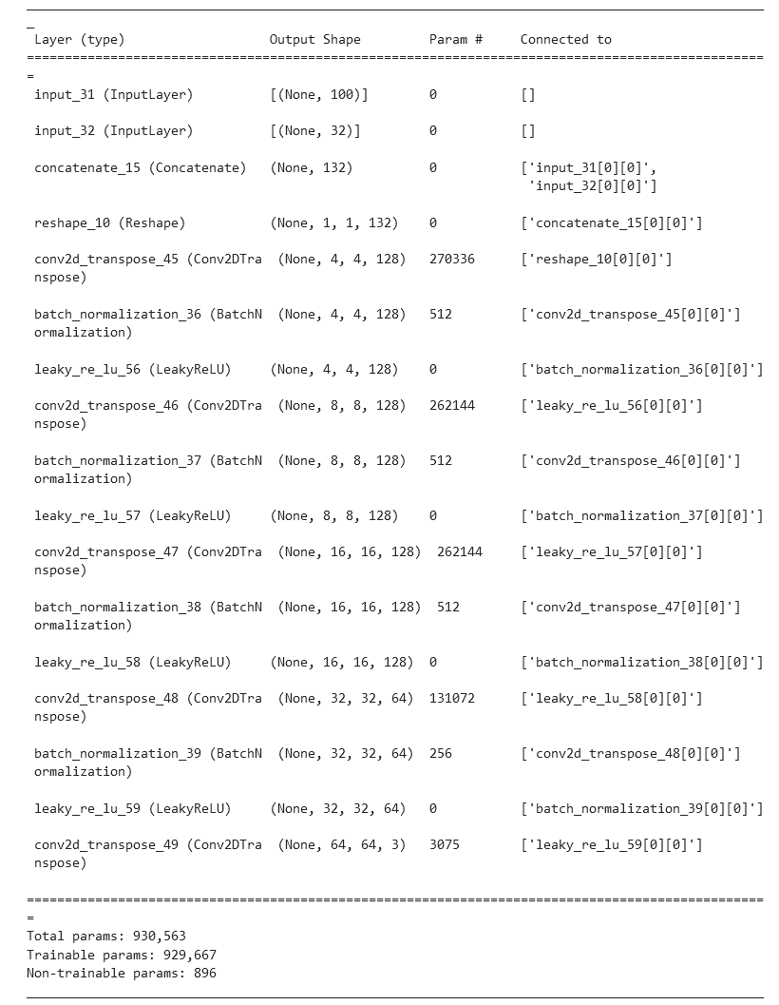
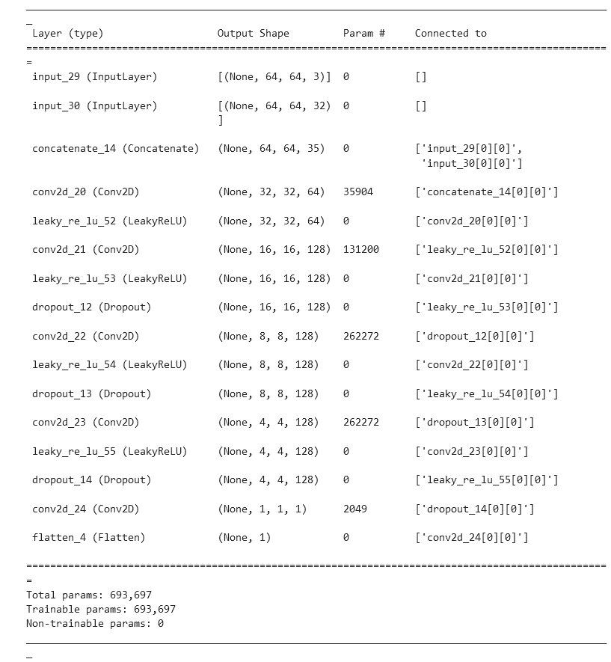
CGAN
Critic
Generator
Notes:
Mike

Slide 11
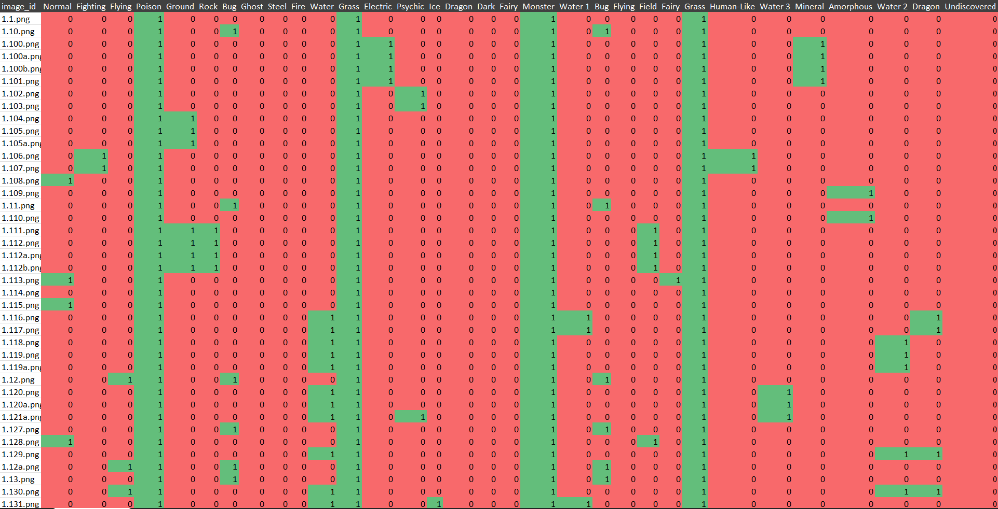
One Hot Encoding
Notes:
One hot encoding
Talk about how

Slide 12
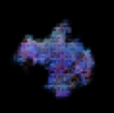
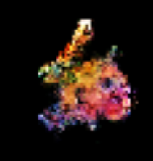
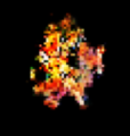
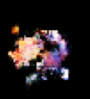
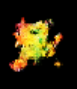
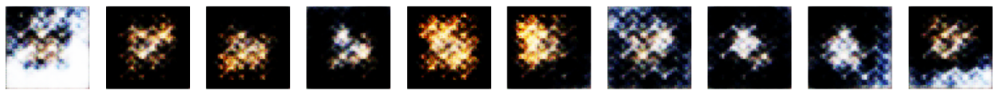
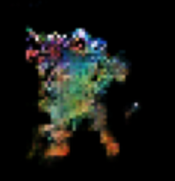
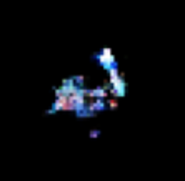
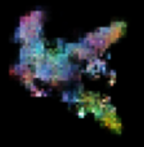
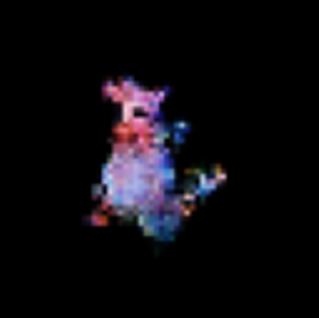
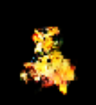
CGan - Output
Dragon
Electric
Ghost
Steel
Fire
Grass
Bug
Flying
Poison
Ground
Notes:
Initial output only with single parameter as a label

Slide 13
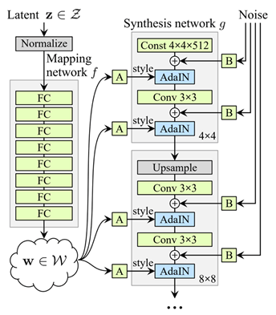
StyleGAN
We use stock implementation of StyleGAN2-ada to learn on our dataset. (Not StyleGAN3 for pragmatic reasons)
Nerdy Details about stylegan in general
Builds on ProGAN (Discriminator Identical); adds style-based generator.
Intention to automatically learn, unsupervised separation of high-level attributes (e.g., pose and identity when trained on human faces)
Injects style vectors into network at different points
New normalization function and pipeline ensures that style vectors only affect features at particular layer
Results are (supposed to be) more disentangled
Notes:
Overview
ProGAN paper suggests first training the generator and discriminator on low-resolution images of, say, 4 × 4 pixels and then incrementally adding layers throughout the training process to increase the resolution.
the discriminator from progan is identical; only the generator is changed in styleGan.
While ProGAN generates fantastically realistic images, it is no exception to this general rule. We would ideally like to have full control of the style of the image, and this requires a disentangled separation of features in the latent space.
StyleGAN achieves this by explicitly injecting style vectors into the network at different points: some that control high-level features (e.g., face orientation) and some that control low-level details (e.g., the way the hair falls across the forehead).
The adaptive instance normalization layers ensure that the style vectors that are injected into each layer only affect features at that layer, by preventing any style information from leaking through between layers. The authors show that this results in the latent vectors
𝐰
being significantly more disentangled than the original
𝐳
vectors.

Slide 14
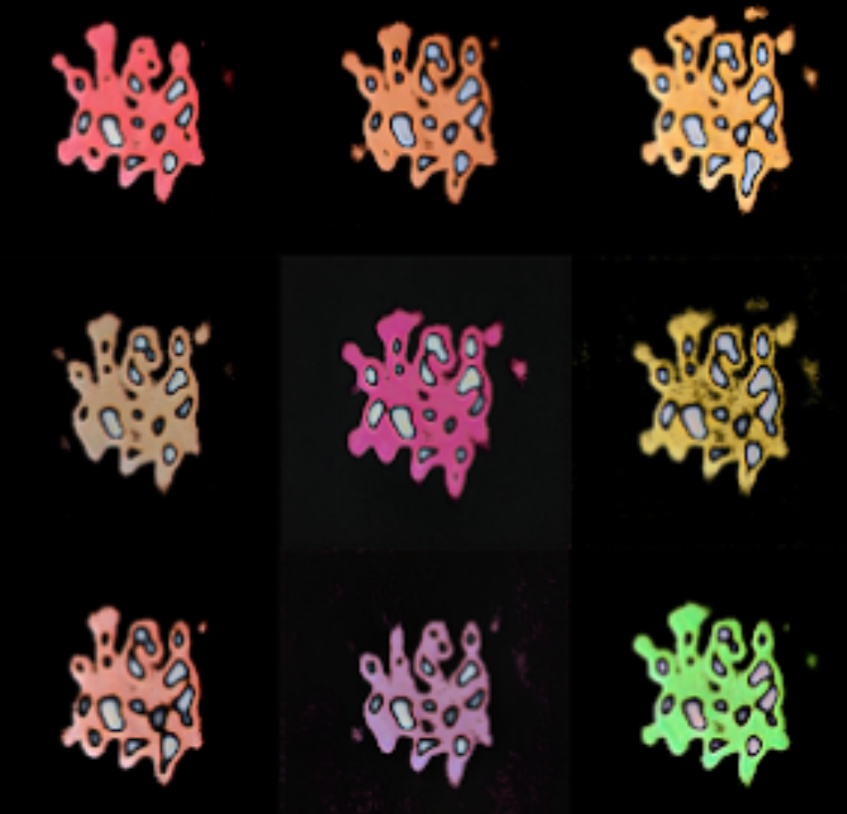
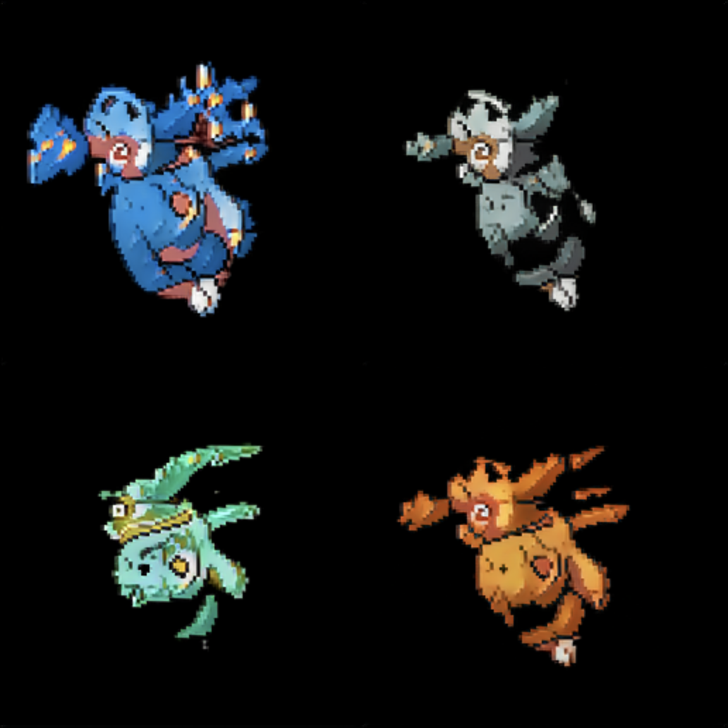
StyleGan - Output
After 2.5 hours
After (probably) 12 hours

Slide 15
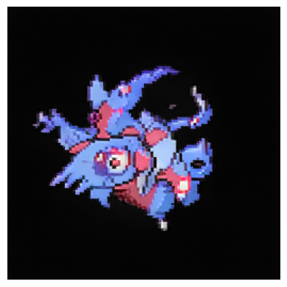
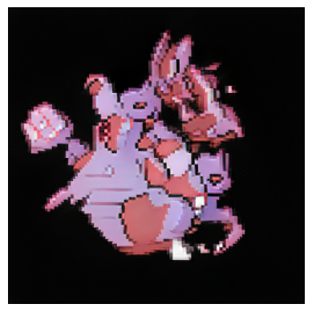
Exploring Latent Space in the StyleGAN
Colab
https://colab.research.google.com/drive/1A5EMTFezPs6eTBJKBBh9MMH2pw06EBtZ?usp=sharing

Slide 16
Challenges
Computational Resource Intensive
Convergence of output

Slide 17

Potential Future Works
Play with hyperparameters more and train for longer to (possibly) generate better results
Classify data by pokemon and not just types and egg groups
Combine a CGAN and StyleGan

Slide 18
Thanks

